Slide 1
Object Oriented Programming Week-1 Feb 08-11, 2021
Instructor:
Dr. Abdul Aziz
Assistant Professor
(Department of Software Engg. )
National University- FAST (KHI Campus)

Slide 2
acknowledgment
- Publish material by Virtual University of Pakistan.
- Publish material by Deitel & Deitel.
- Publish material by Robert Lafore.

Slide 3
Google Classroom Link
Please Join Using the code:
ytrv6k2

Slide 4
What you have done so far !
- Introduction to Computer Programming (ITC):
How to think a program.
How to write a program.
Basic Programming structure.
Procedural paradigm.
Group of functions that interact with each other.
- Already have knowledge about the offered course.
- Need to strengthen our concepts.
- Try to implement what we know.

Slide 5
Computer Programming as a course
What we will study:
Object Oriented Programming.
How to think in a OOP way.
How to map real world into a program
Or, how to program a real world scenario.
Aim :
Our aim is to lean the concepts of Object Oriented programming.
Try to digest them.
Implement in a program.
Tool: C++.

Slide 6
Contents of the Course
- Object Oriented Programming.
- Classes & Objects.
- Overloading.
- Inheritance.
- Polymorphism.
- Generic Programming.
- Exception Handling.

Slide 7
Books
Text Book:
1- C++ How to program By Deitel & Deitel.
Reference Books:
1- The C++ Programming Language By Bjarne Stroustrup.
2- Object Oriented Software Engineering By Jacobson.

Slide 8
Grading policy
Assignments 10 at least four
Project 10 one in group
Midterm’s 30 two (15 marks each)
Final 50
_____
Total 100

Slide 9
—Chinese Proverb
Tell me and I forget.
Show me and I remember.
Let me do and I understand.

Slide 10
Week One, class one
- Introduction to the Generation of Languages
- Introduction to Software Development
- Introduction to Programming Paradigms

Slide 11
What Are the Types of Programming Languages
First Generation Languages
Second Generation Languages
Third Generation Languages
Fourth Generation Languages
Fifth Generation Languages

Slide 12
First Generation Languages
Machine language
Operation code – such as addition or subtraction.
Operands – that identify the data to be processed.
Machine language is machine dependent as it is the only language the computer can understand.
Very efficient code but very difficult to write.

Slide 13
Second Generation Languages
Assembly languages
Symbolic operation codes replaced binary operation codes.
Assembly language programs needed to be “assembled” for execution by the computer. Each assembly language instruction is translated into one machine language instruction.
Very efficient code and easier to write.

Slide 14
Third Generation Languages
High Level Languages
Closer to English but included simple mathematical notation.
Programs written in source code which must be translated into machine language programs called object code.
The translation of source code to object code is accomplished by a machine language system program called a compiler.

Slide 15
Third Generation Languages (cont’d.)
Alternative to compilation is interpretation which is accomplished by a system program called an interpreter.
Common third generation languages
FORTRAN
COBOL
C and C++
Visual Basic

Slide 16
Fourth Generation Languages
Event based programming
A high level language (4GL) that requires fewer instructions to accomplish a task than a third generation language.
Used with databases
Query languages
Report generators
Forms designers
Application generators

Slide 17
Fifth Generation Languages
Artificial Intelligence
Machines that can think like humans
Machines that takes its own decisions

Slide 18
Software
► Computer Software is the product that software engineers design and build.
► It encompasses –programs that execute within a computer of any size and architecture,
– documents that encompass hard-copy and virtual forms,
– data that combine numbers and text but also includes representations of pictorial, video and audio information.

Slide 19
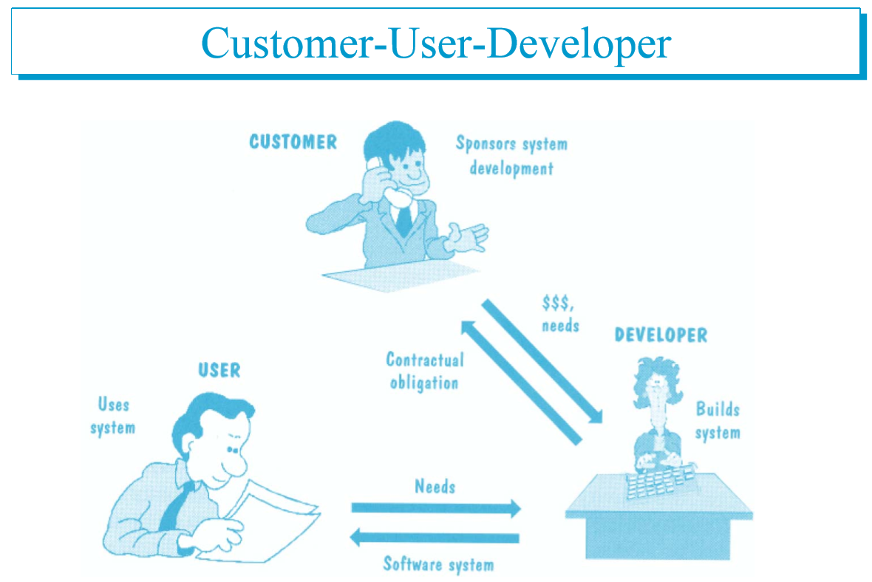

Slide 20
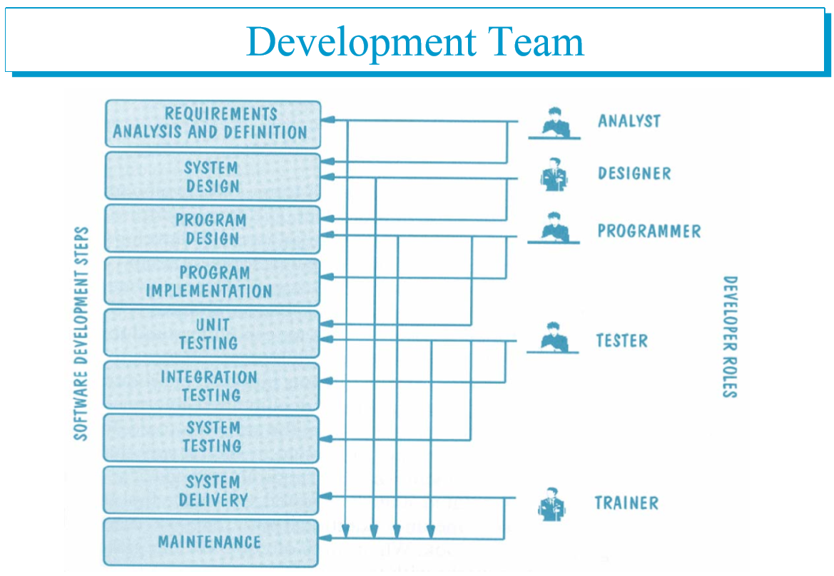

Slide 21
Week one, class two
- Introduction to OO paradigm
- Principles of Object Oriented Paradigm

Slide 22
Programming Paradigms
1- Sequential
2- Procedural
3- Object Oriented

Slide 23
Programming Paradigms
Data Oriented
Process Oriented
Object Oriented
Think in term of data that we needed
Think in term of Process that we needed
Think in term of Object that is involved

Slide 24
What is object orientation
- A technique for system modeling.
- OO model consists of several interacting objects.

Slide 25
What is a Model?
- abstraction of something.
- Purpose is to understand the product before developing it.

Slide 26
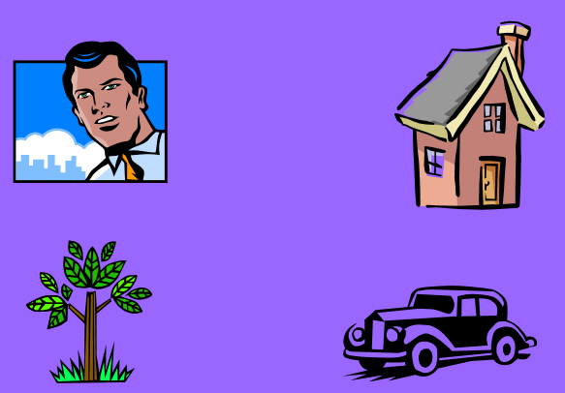
Example – OO Model

Slide 27
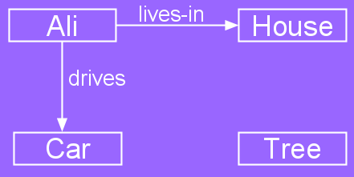
Example – OO Model
Objects
Person i.e Name: Ali
House
Car
Tree
Interactions
Ali lives in the house
Ali drives the car

Slide 28
Object-Orientation - Advantages
- People think in terms of objects
- OO models map to reality
Therefore, OO models are:
- easy to develop
- easy to understand

Slide 29
Five principles of OO paradigm
1- Abstraction: To have the relevant information.
2- Encapsulation: To hide information inside the object.
3- Polymorphism: To have many shapes / behaviors.
4- Inheritance: To create a new object with an existing one (To adopt features from others)
5- Reusability: Ability to use an object again and again if needed.

Slide 30
Week one, class three
- Introduction to Object

Slide 31
What is an Object?
An object is:
- It can be anything for which we want to save Information
- Something tangible (Ali, Car)
- Something that can be captured intellectually (Time, date)
An object has:
State / attributes / properties / data
Well-defined behavior / methods / functions
Unique identity

Slide 32
Ali as an object
Attributes:
Name
age
Behavior (operations)
Walks
Eats
Identity
His name

Slide 33
Car as an Object
State (attributes)
Color
Model
Behavior (operations)
Accelerate
Start Car
Change Gear
Identity
Its registration number

Slide 34
Visualizing an Object
Functions/Methods/Behavior
Objects Data / Attributes / States

